Slide 1
Fundamentals of CRE
Chemical Reaction Engineering
By
Dr Salah N. Farhan
Senior lecturer. Chem. Eng. Dept.
College of Engineering
University of Diyala
Salah N. Farhan College of Engineering Diyala University

Slide 2
Fundamentals of CRE
Chapter 2: Conversion and Reactor Sizing
Salah N. Farhan College of Engineering Diyala University

Slide 3
Fundamentals of CRE
Critical Thinking Question
See Preface Tables P1, P2, and P3
Would the conversion be higher if the PFR were placed at last rather than in the middle? This is a question that involves critical thinking because it probes implication and consequences of such a move of the PFR
Socratic Question 5:
By moving the PFR to the end more conversion will be achieved because the rate decreases gradually as we move down the PFR. (see example 2.2 for a similar situation)
Salah N. Farhan College of Engineering Diyala University

Slide 4
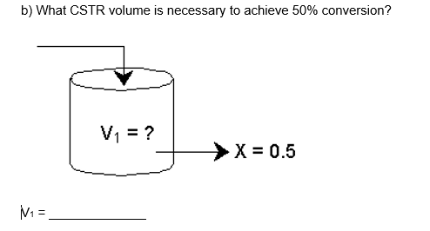
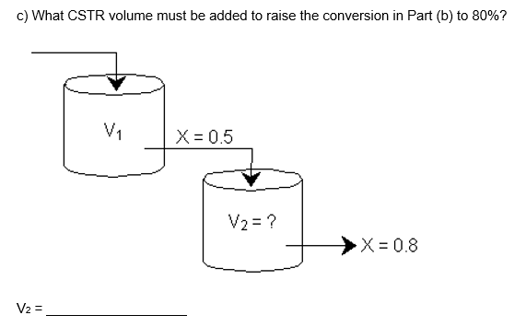
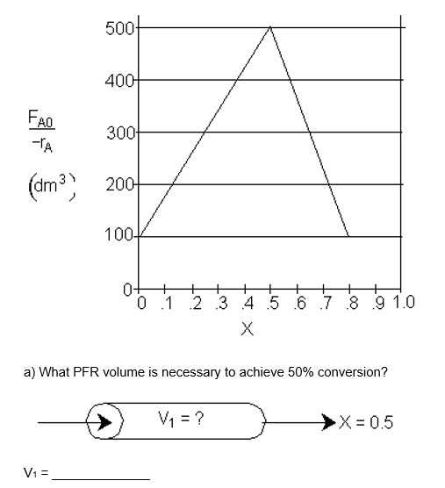
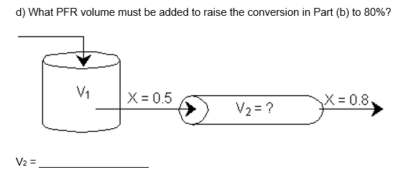
Fundamentals of CRE
Salah N. Farhan College of Engineering Diyala University

Slide 5
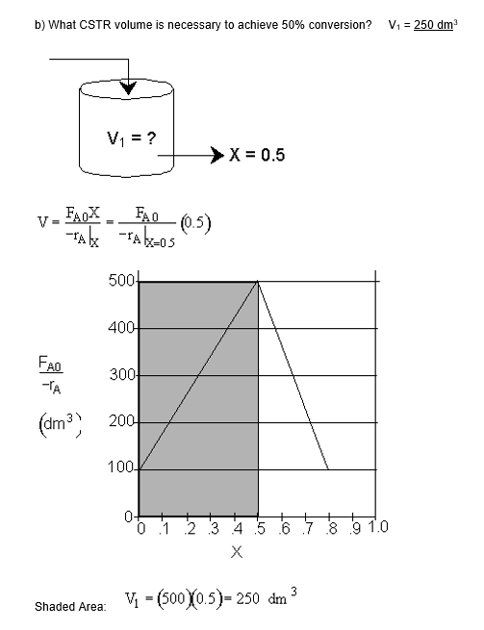
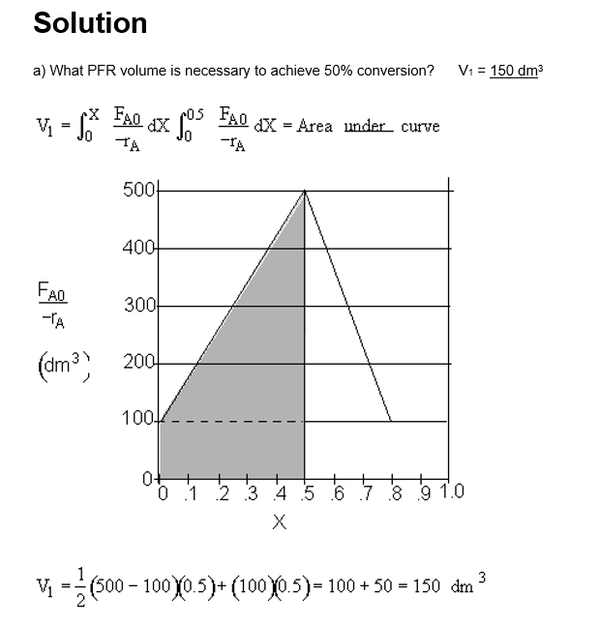
Fundamentals of CRE
Salah N. Farhan College of Engineering Diyala University

Slide 6
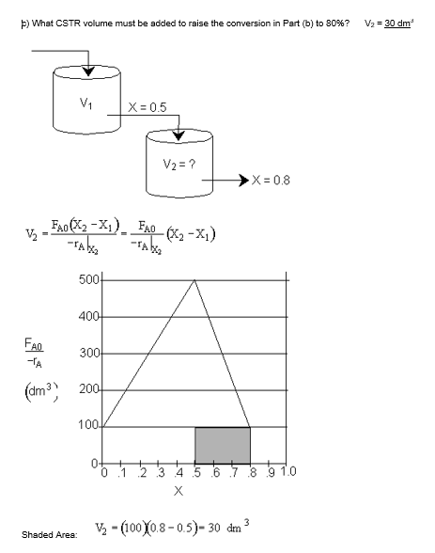
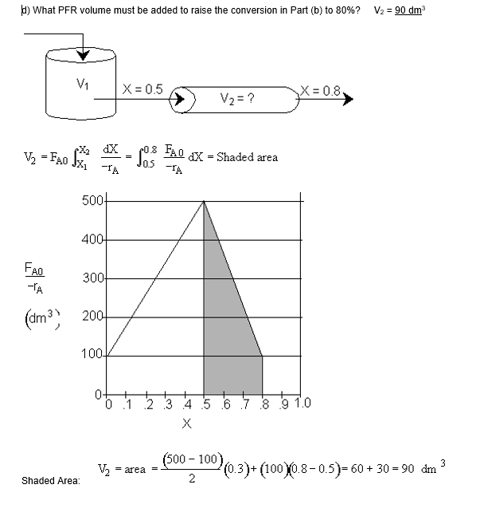
Fundamentals of CRE
Salah N. Farhan College of Engineering Diyala University

Slide 7
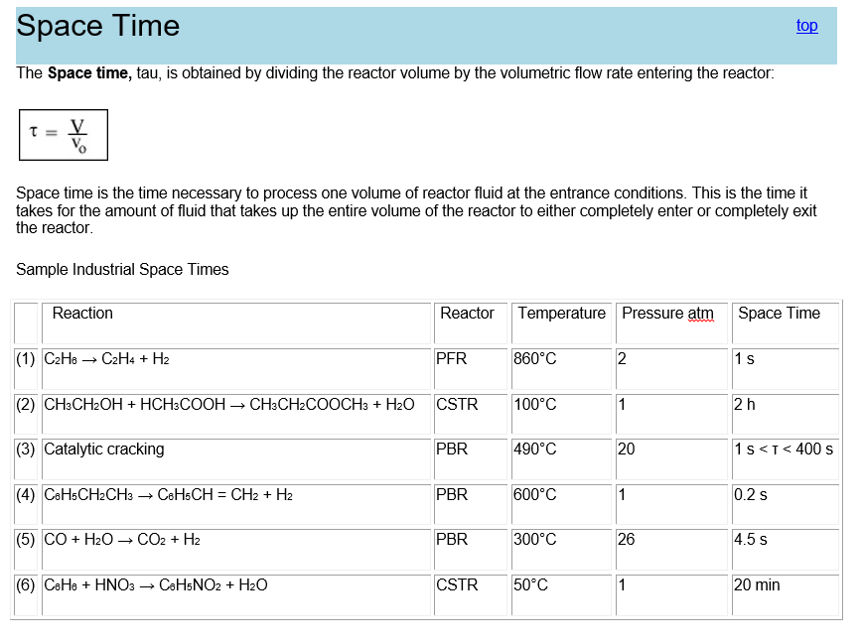
Fundamentals of CRE
Salah N. Farhan College of Engineering Diyala University

Slide 8
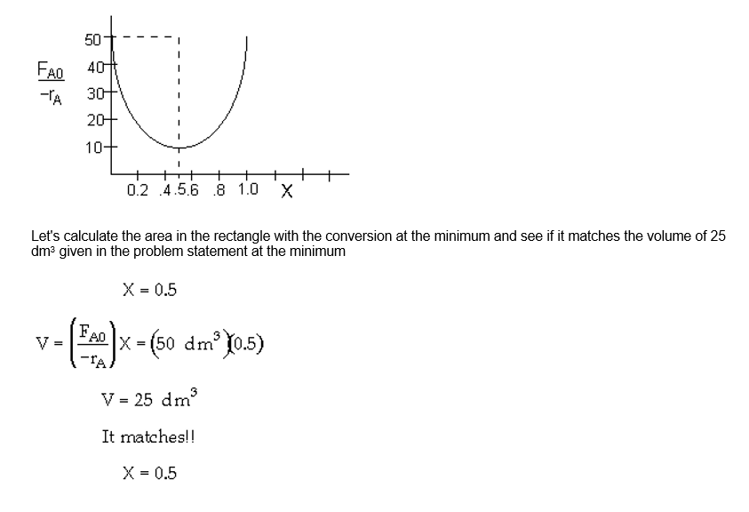
Fundamentals of CRE
Self Test - What is Wrong with This Solution?
Problem
An adiabatic liquid phase exothermic reaction is to be carried out in a 25 dm³ CSTR. The entering molar flow rate of A times the reciprocal of the rate of reaction is shown below as a function of conversion.
What is the conversion exiting the CSTR?
Salah N. Farhan College of Engineering Diyala University

Slide 9
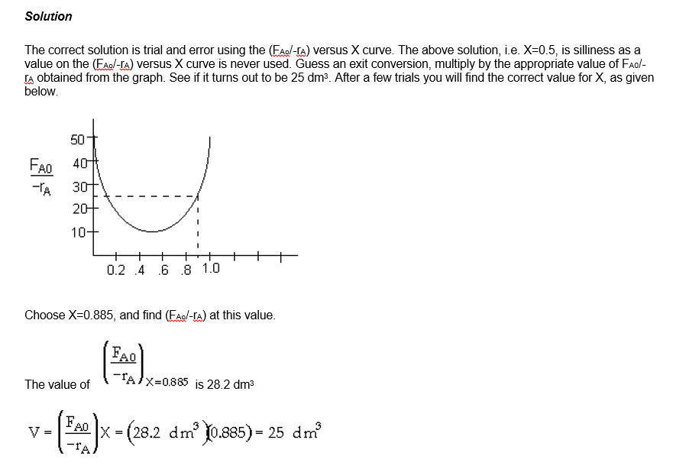
Fundamentals of CRE
Salah N. Farhan College of Engineering Diyala University

Slide 10
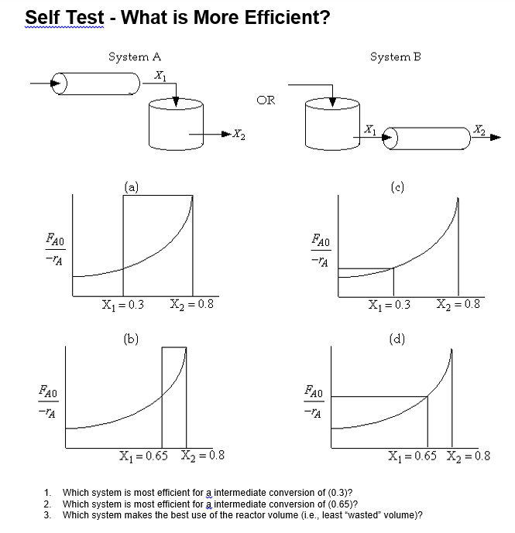
Fundamentals of CRE
Salah N. Farhan College of Engineering Diyala University

Slide 11
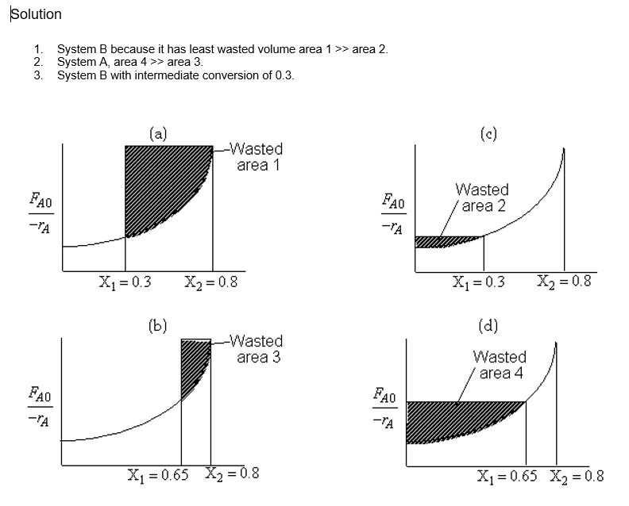
Fundamentals of CRE
Salah N. Farhan College of Engineering Diyala University

Slide 12
Fundamentals of CRE
Salah N. Farhan College of Engineering Diyala University

